Slide 1
NTE 1010
Introduction to Finance for Engineers
Spring 2020
week
11
Monetary Policy

Slide 2
NTE 1010 – Introduction to Finance for Engineers
Monetary Policy
Monetary Policy is the policy adopted
by the monetary authority of a country (the Central Bank)
that controls either the interest rate payable on very short-term borrowing or the money supply, often targeting inflation or the interest rate
to ensure price stability and general trust in the currency.
Unlike Fiscal Policy which relies on government to spend its way out of recessions,
Monetary Policy aims to manipulate the money supply, i.e. 'printing' more money
or decreasing the money supply
by changing interest rates or removing excess reserves.

Slide 3
NTE 1010 – Introduction to Finance for Engineers
Monetary Policy
Price Stability
Getting monetary policy right is crucial to the health of the economy.
Overly expansionary monetary policy leads to high inflation,
which decreases the efficiency of the economy and hampers economic growth.
Monetary policy that is too tight can produce serious recessions
in which output falls and unemployment rises.
It can also lead to deflation, a fall in the price level,
such as occured in the US during the Great Depression (1933-1939)
and in Japan more recently.
Primary goal is the Price Stability which is defined as low and stable inflation.
It is desirable because a rising price level (inflation) creates uncertainty in the economy,
and that uncertainty might hamper economic growth.

Slide 4
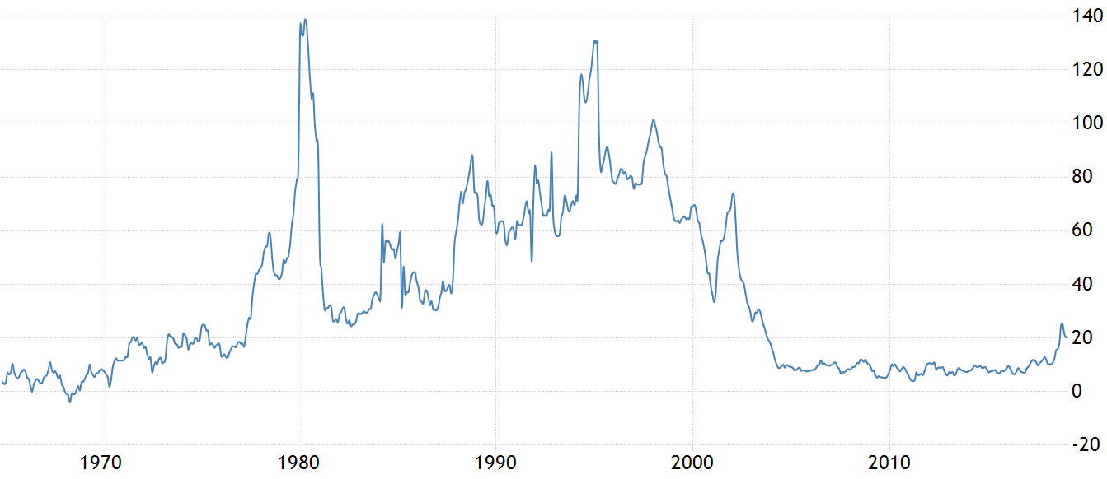
NTE 1010 – Introduction to Finance for Engineers
Monetary Policy
Inflation in Turkey, Annual CPI

Slide 5
NTE 1010 – Introduction to Finance for Engineers
Monetary Policy
Other Goals
High employment and economic growth
    The goal is not zero unemplyment level but a level above zero
    that is consistent with full employment at which the demand for labor equals the supply of labor.
    This level is called the natural rate of unemployment.
    Since the level of unemployment is tied to the level of economic activity in the economy,
    a particular level of output is produced at the natural rate of unemployment,
    which is referred to as the natural rate of output or more commonly as the potential output.
Stability of financial markets
    Financial crises can interfere with the ability of financial markets
    to channel funds to people with productive investment opportunities
    and lead to sharp contraction in the economic activity.
Interest-rate stability
    is desirable because fluctuations in interest rates can create uncertainty in the economy
    and make it harder to plan for the future.
    Fluctuations in interest rates affect consumers’ willingness to buy houses, for example.
Stability in foreign exchange markets
    With the increasing importance of international trade to the economies, FX stability is crucial.

Slide 6
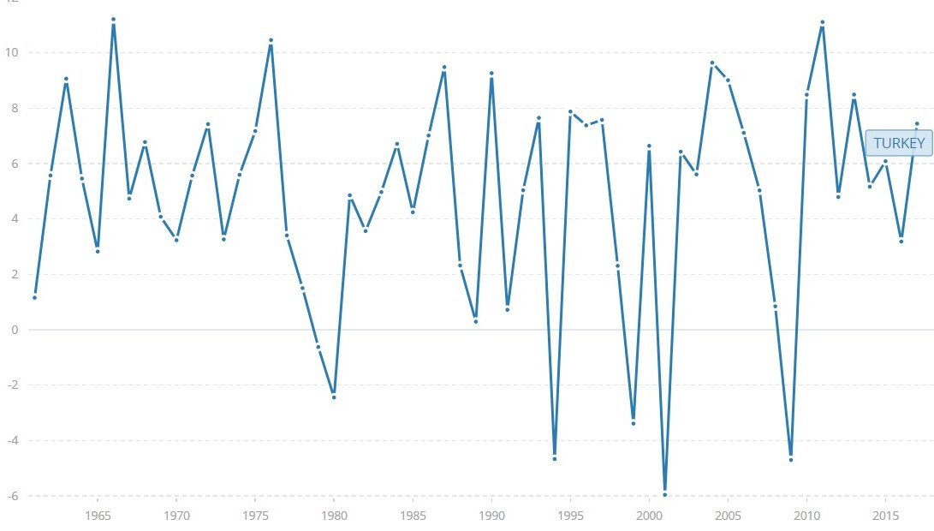
NTE 1010 – Introduction to Finance for Engineers
Monetary Policy
Economic Growth Rate in Turkey, Annual %

Slide 7
NTE 1010 – Introduction to Finance for Engineers
Monetary Policy
Nominal Anchor
A nominal variable such as the inflation rate or the money supply,
which ties down the price level to achieve price stability.
Having a strong nominal anchor is a key element in successful monetary policy.
Nominal anchor also limits the time-inconsistency problem,
in which monetary policymakers conduct monetary policy
in a discretionary way that focuses on short-term objectives
but produces poor long-run outcomes.
Actually, the time-inconsistency problem is something that we deal with
continually in our everyday life.

Slide 8
NTE 1010 – Introduction to Finance for Engineers
Monetary Policy
Inflation Targeting
Advantages:
      enables monetary policy to focus on domestic considerations
      readily understood by the public and is highly transparent
      increases accountability of the central bank
      appears to ameliorate the effects of inflatinary shocks
Disadvantages:
    inflation is not easily controlled by the monetary authorities,
    so that an inflation target is unable to send
    immediate signals to both the public and markets
    might impose a rigid rule on policy makers,
    although this has not been the case in practice
    a sole focus on inflation may lead to larger output fluctuations,
    although this has also not been the case in practice
In recent years, the Federal Reserve of US has had a strategy of having an implicit nominal anchor.
It has had a demonstrated success, producing low inflation
with the longest business cycle expansion in US history.

